Slide 1
algorithms and complexity (CSc 540)
Ram Krishna Dahal
Asst. Professor
Central Department of computer science and IT

Slide 2
Course Description
The course can be viewed as a continuation of Design and Analysis of Algorithms, and its goal is to cover basic algorithmic techniques that are not covered in the subject. In particular, we will discuss NP Completeness in detail, approximation algorithms for NP-hard problems, Randomized Algorithms, online algorithms, PRAM algorithms, Mesh Algorithms and Hypercube Algorithms.

Slide 3
Course Objectives
The purpose of this course is to present depth in optimization paradigms, Some advance algorithm design techniques and moderate level understanding in computational complexity theory

Slide 4
Prerequisites
Linear Algebra, Data Structure and algorithm, Basic Course in Algorithm design, Programming language

Slide 5
Algorithm design techniques
Divide and conquer technique (Top-down approach, Divide, solve and compile)
Greedy approach (Looks best at the moment, not always guarantee to optimal solution)
Dynamic programming (Bottom-up approach, solve all small problems and then combine to obtain solutions for bigger problems)
Branch and bound (only minimization)
Randomized algorithms (uses a random number at least once during the computation make a decision.)
Back tracking algorithms (tries each possibility until they find the right one)

Slide 6
Amortized Analysis
Amortized Analysis is used for algorithms where an occasional operation is very slow, but most of the other operations are faster. In Amortized Analysis, we analyze a sequence of operations and guarantee a worst case average time which is lower than the worst case time of a particular expensive operation.
∑ amortized cost >= ∑actual coste
i.e. O(amortized cost) >= O(actual cost)

Slide 7
Amortized analysis
Only applicable in certain cases i.e. when some of operations are fast and some are slow
Finding general operation that is applicable to this data structure
There three ways of doing amortized analysis,
Aggregate analysis
Accounting model
Potential model

Slide 8
Aggregate analysis
Simplest way to perform amortized analysis
Just get an average
O(Total Cost) ÷ Number of Operations

Slide 9
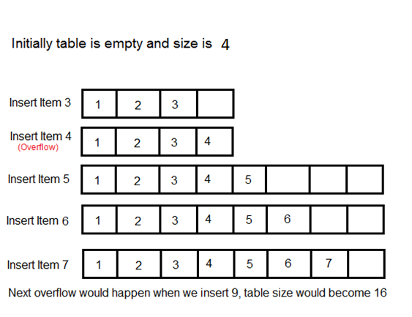
Dynamic array - example
We want to insert unknown number of array
What is the time complexity of general operation on this data structure?

Slide 10
Aggregate analysis
Total cost under big O notation (for total n numbers to be inserted)
O(∑ cost of n operations)
O (∑ cost of cheap operations + ∑ cost of expensive operations)

Slide 11
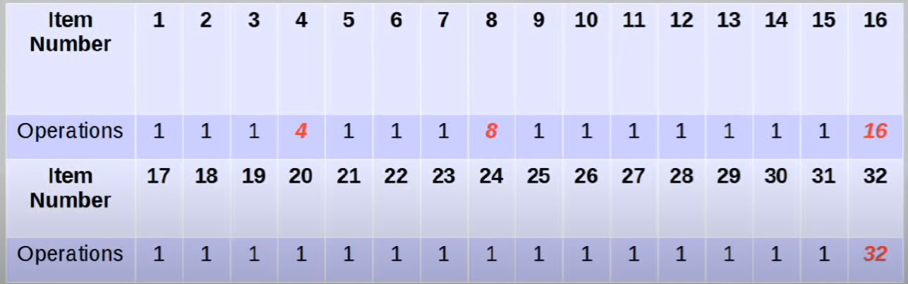
Up to 32 items total cost of operations =63

Slide 12
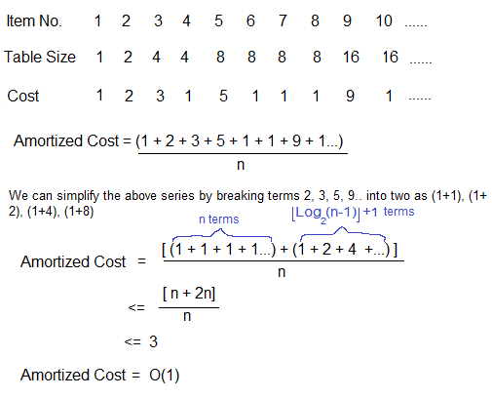
Aggregate analysis
Total cost < 2× Numbers of item
Total cost <2n
O(2n)
O(n)
Performing the averaging
Amortized time =O(n)÷n = O(1)

Slide 13
Accounting method
We assign every operation a cost probably guessing what assignment will work
- Any surplus goes to bank
Idea : need to overcharge for the simpler operations
Build up enough saving to afford a more expensive operation later
Maintaining a credit and use it in,
Credit = amortized cost – actual cost
Challenge: Bank balance must always be 0 or greater

Slide 14
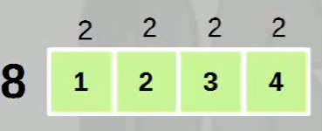
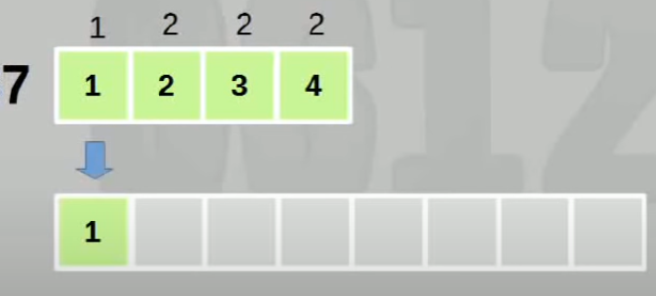
Accounting method
For the dynamic array, charge 3 units per operation

Slide 15
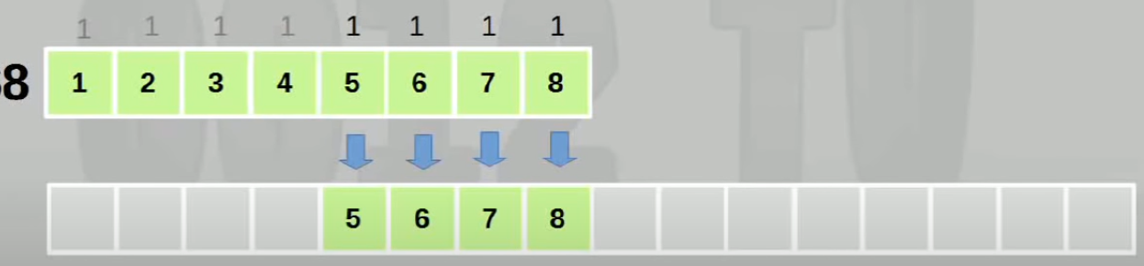
Accounting method

Slide 16
Accounting method
Since each operation has a constant cost (3),
Under the big O notation
Amortized time = O(3) = O(1)

Slide 17
Potential method
In the potential method, a function P(n) is selected that converts states of the data structure to non-negative numbers. P(n) may be imagined as calculating the amount of potential energy stored in that state. Before initializing a data structure, the potential value is defined to be zero.
- Conceptually similar to accounting method
Same concept of using a stored surplus to pay for more expensive operations
The potential is analogous to the bank
Potential most also always be 0 or greater

Slide 18
Potential method
Key differences: bank balance of a particular state is dependent on previous state
Potential method involves a potential function
The potential is represented by a function P(n)
P(n)>=0 for all n

Slide 19
Potential method
Finding a potential function is challenging part
For dynamic array P(n) = 2n-size
For 1 item,
P(1)=2n-size= 2-2=0
P(2)=2n-size= 4-4=0
P(3)=2n-size= 6-4=2

Slide 20
Potential method
Amortized time of ith operations
Ci + P(i) –P (i-1)
For dynamic array,
P(i) = 2n-size

Slide 21
Potential method
Normal case,
Ci + P(i) –P (i-1)
=1+2i-size-2(i-1)+size
=3
Expansion case,
Ci +P(i) –P (i-1)
=i+1+2i-size-2(i-1)+size
=i+1+2i-2i-2(i-1)+i
=3
In both case,
O(3)=O(1)

Slide 22
Comparison
Accounting Method
we assign amortized costs to the operations (probably by guessing what assignment will work), compute the P(i)s using
P(i) = amortized(i) - actual(i) + P(i-1)
and show that P(n)-P(0) >= 0
Potential Method
we start with a potential function (probably obtained using good guess work) that satisfies Equation
P(n)-P(0) >= 0
and compute the amortized complexities using Equation
P(i) = amortized(i) - actual(i) + P(i-1)

Slide 23
Summery
Although, at this time, you may feel most comfortable with the aggregate method. this method is often the hardest to use because it is often quite difficult to obtain a bound on the aggregate actual cost that is smaller than the bound obtained by using the worst-case cost of each operation in the sequence. The accounting method is intuitive (we simply verify that the sum of the amortized costs is at least equal to the sum of the actual costs) and often results in tight bounds on the complexity of a sequence of operations. The potential method is often the hardest to use (because of the difficulty of determining the proper potential function to use), but for some applications remains the only way to obtain tight complexity bounds.

Slide 24
Maintenance Contract
In January, you buy a new car from a dealer who offers you the following maintenance contract: $50 each month other than March, June, September and December (this covers an oil change and general inspection), $100 every March, June, and September (this covers an oil change, a minor tune-up, and a general inspection), and $200 every December (this covers an oil change, a major tune-up, and a general inspection). We are to obtain an upper bound on the cost of this maintenance contract as a function of the number of months

Slide 25
Aggregate method
To use the aggregate method for amortized complexity, we first determine an upper bound on the sum of the costs for the first n months. As tight a bound as is possible is desired. The sum of the actual monthly costs of the contract for the first n months is 200*floor(n/12) + 100*(floor(n/3) - floor(n/12)) + 50*(n - floor(n/3)) = 100*floor(n/12) + 50*floor(n/3) + 50*n <= 100*n/12 + 50*n/3 + 50*n = 50n(1/6 + 1/3 + 1) = 50n(3/2) = 75n

Slide 26
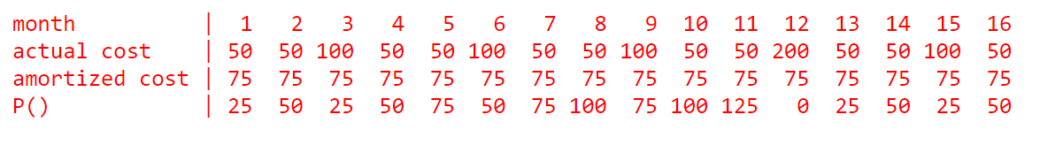
Presenting in a table

Slide 27
Potential method
If we are extremely experienced, we might start with the potential function P(0) = 0 P(n) = 0 for n mod 12 = 0 P(n) = 25 for n mod 12 = 1 or 3 P(n) = 50 for n mod 12 = 2, 4 or 6 P(n) = 75 for n mod 12 = 5, 7 or 9 P(n) = 100 for n mod 12 = 8, or 10 P(n) = 125 for n mod 12 = 11

Slide 28
The McWidget Company
The famous McWidget company manufactures widgets. At its headquarters, the company has a large display that shows how many widgets have been manufactured so far. Each time a widget is manufactured, a maintenance person updates this display. The cost for this update is $c + dm, where c is a fixed trip charge, d is a charge per display digit that is to be changed, and m is the number of digits that are to be changed. For example, when the display is changed from 1399 to 1400, the cost to the company is $c + 3d because 3 digits must be changed. The McWidget company wishes to amortize the cost of maintaining the display over the widgets that are manufactured, charging the same amount to each widget. More precisely, we are looking for an amount $e = amortized(i) that should leavied against each widget so that the sum of these charges equals or exceeds the actual cost of maintaining/updating the display ($e*n >= actual total cost incurred for first n widgets for all n >= 1). To keep the overall selling price of a widget low, we wish to find as small an e as possible. Clearly, e > c + d because each time a widget is made, at least one digit (the least significant one) has to be changed.

